Slide 1

M&C Saatchi World Services LLP
By: Christopher Leung

Slide 2
SQL Project

Slide 3

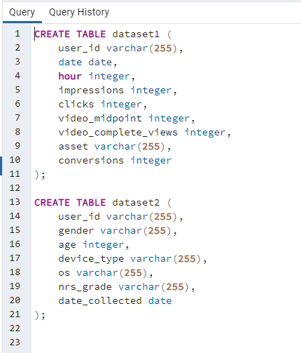
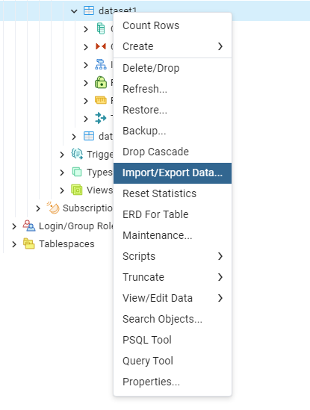
Installation & Loading data
Install PgAdmin4 and PostGreSQL.
Create tables for dataset1 and dataset2
Import the data by csv files

Slide 4
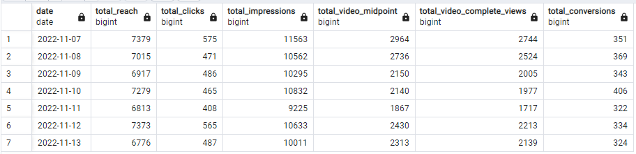
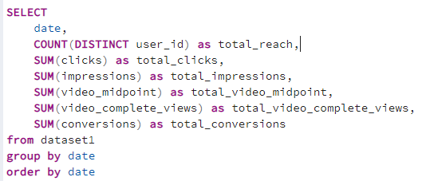
Basic Initial Statistics
I took the sum of data to calculate total reach, total clicks, total impressions, etc. I have the SQL code and results to the right.
Based on these stats, nothing truly sticks out to me. All I can tell is total conversions on 11/10/2022 was at its highest between all of the days. I would’ve thought total impressions had a greater effect on conversions but that does not appear to be the case.
I wanted to compare the numbers for each day to see how it is trending and to see if there are data quality or outliers to look into.

Slide 5
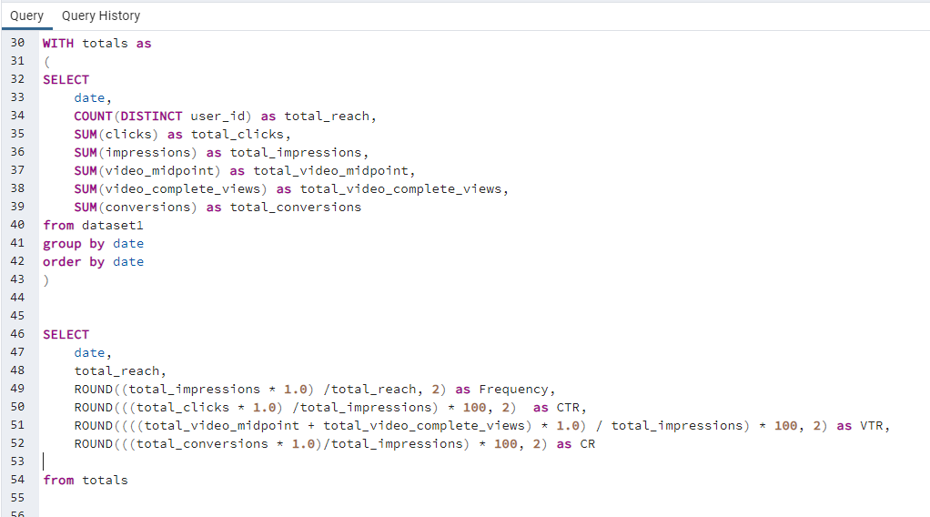
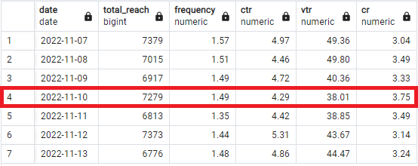
Developing metrics
I went to create the KPI metrics for Reach, Frequency, CTR, VTR, and CR.
My PostGreSQL query and the result is to the right. I decided to use Common Table Expressions (CTEs) instead of subquery to code the SQL neater.
I grouped the data by date so we can get an idea of all the KPIs performance day over day. Without grouping this by day, we won’t have a way to make comparisons.
From the previous statistics, I am still noticing that on 11/10/2022 there is a compelling story to tell.
With CR at its highest, it simply means the day’s conversion rate was the best out of the other days. VTR rate was the lowest but not really sure if this is just coincidence.

Slide 6
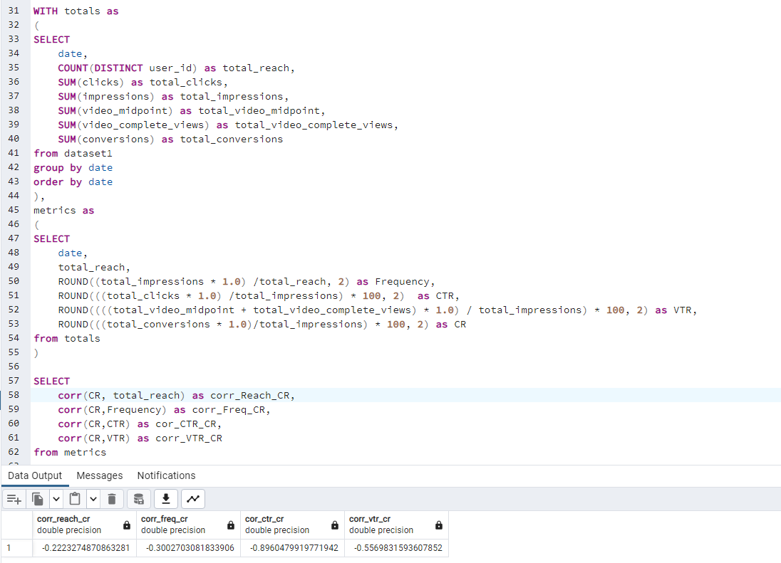
Analyzing metrics through correlation (pt 1)
To verify if this is coincidence or reality, I decided to use correlation math function within SQL that allows us to understand the relationship between CR and the other metrics.
Correlation simply means if a value goes up, does the other value go in the same direction or opposite direction and also how strong is this relationship.
You can see the SQL code to the right and its output. It appears the relationship between VTR and CR (-0.56) is relatively weak compared to CTR and CR (-0.89).
CTR and CR has the strongest inverse relationship, when CTR goes down, CR goes up and vice versa. This makes a LOT of sense as the ideal CTR rate is 1 to 1. For each impression, you want a click. This is efficient in terms of performance of your ads.

Slide 7
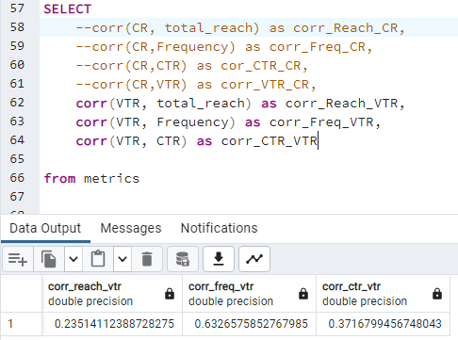
Analyzing metrics through correlation (pt 2)
Since CTR has a relationship with CR, I wanted to check if VTR had a relationship with the other metrics.
As you can see the SQL code and results to the right, it doesn’t appear there is much relationship between VTR and the other metrics.

Slide 8
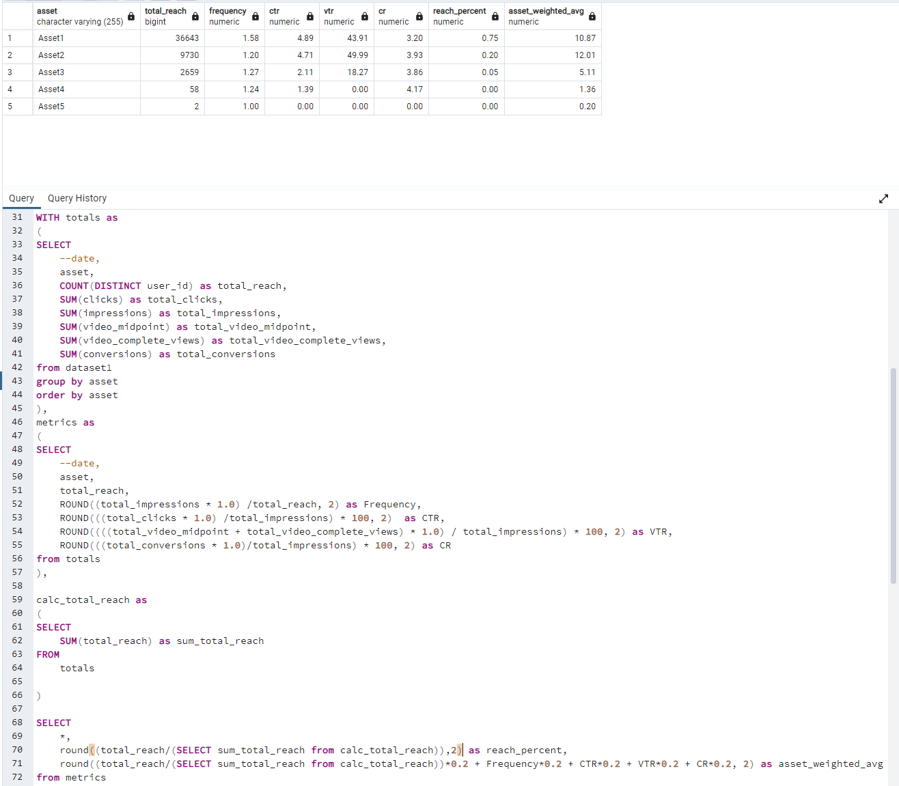
Utilize metrics per Asset
Since I had been viewing this on a day to day basis, we would like to compare each asset and their performances.
I have decided to create a formula to help evaluate each Asset based on the metrics provided. Here is my formula for asset evaluation.
Basically the first part of the formula states we take each assets total_reach as a percentage of the entire reach stretched over all assets.
The multiplied 20% number is stating that each metric (total_reach, frequency, etc.) has an equal shared weight in evaluating performance.
Once we sum up the all those values, we get a weighted average. This will evaluate all assets based on their metrics (taking each metric as equal weight).
As you can tell the results (last column) are Asset 2 is the best performer. It makes sense as it has the second highest total reach and CR.
Asset_weighted_avg = ( (Asset total reach /sum(total reach) ) * 0.2 ) + (Asset Frequency * 0.2) + (CTR * 0.2) + (VTR * 0.2) + (CR * 0.2)

Slide 9
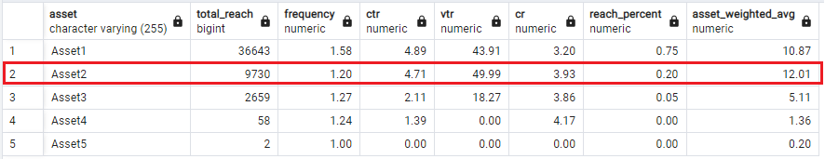
Conclusion
How many people in our target audience did we reach, and what was the engagement for the target audience for each asset in the campaign?
The total people we reached was 48,885 and the engagement evaluation for the best performing asset based on the asset_weighted_avg formula I created is Asset 2.
** Note: the total reach for each asset would be incorrect in comparison to the total reach across the entire dataset. There are assets that share the same user id, creating a duplication of count.

Slide 10
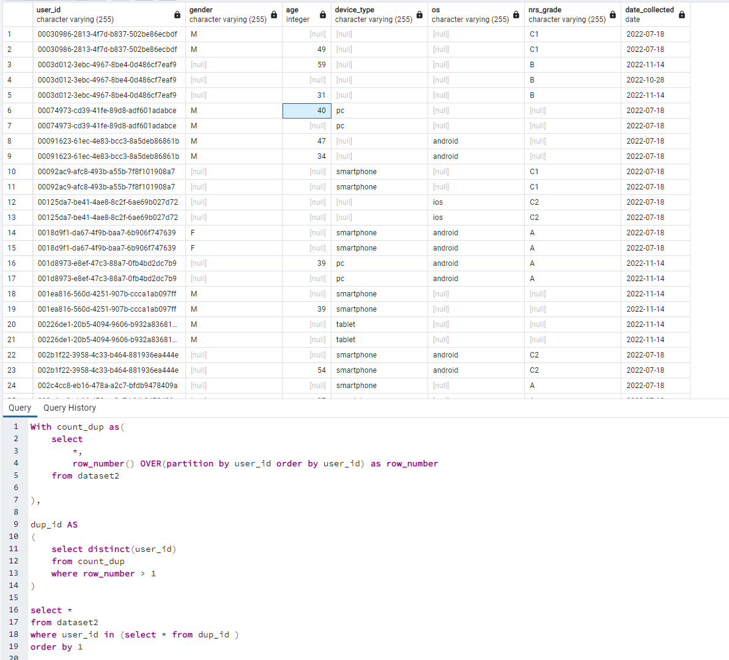
Further analysis (using dataset2)
In this section, I will analyze dataset2 as there is quite a lot of personal data such as gender, type of device used, etc.
In reviewing the data, I noticed there are quite a bit of duplicates for user ids and wanted to see the issues.
I took a CTE of dataset2 and created a window function (row number) to identify the number of duplicate user_ids. Once I have the IDs, I filtered it back into the dataset2 to see the issues.
It appears the data quality issue is due to random issues and its not clear where the resolution may be. There may be multiple individuals accessing devices (possibly due to google log in account). But it still doesn’t make much sense as each person would have their own devices - this is my assumption.

Slide 11
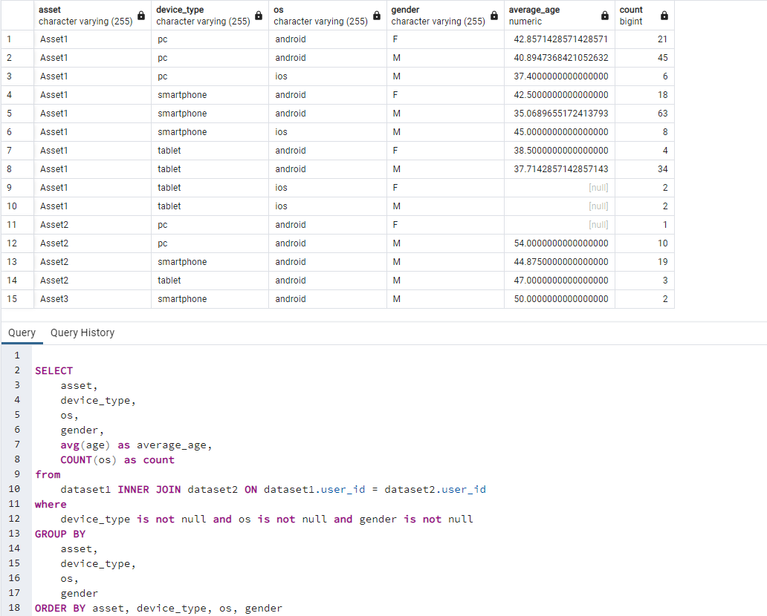
Further analysis (using dataset2)
I decided to ignore the data quality issues for now, just so I can see how the data will look if I joined dataset1 with dataset2.
I took the inner join between dataset1 and dataset2, created a column for average_age, and a count. I also excluded all null values within device_type, os and gender.
The results are shown to the right.

Slide 12
Python Project

Slide 13
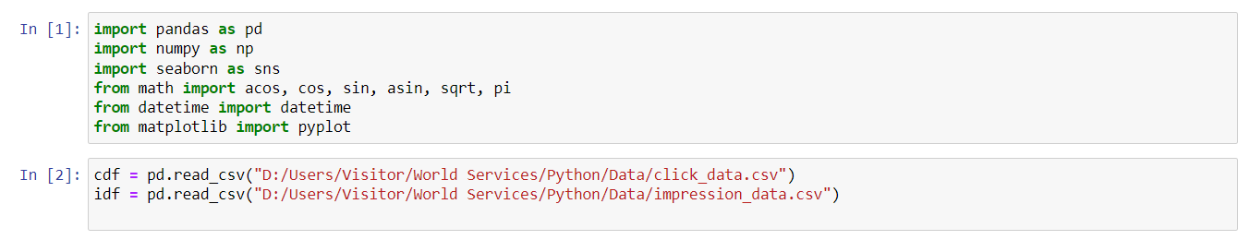
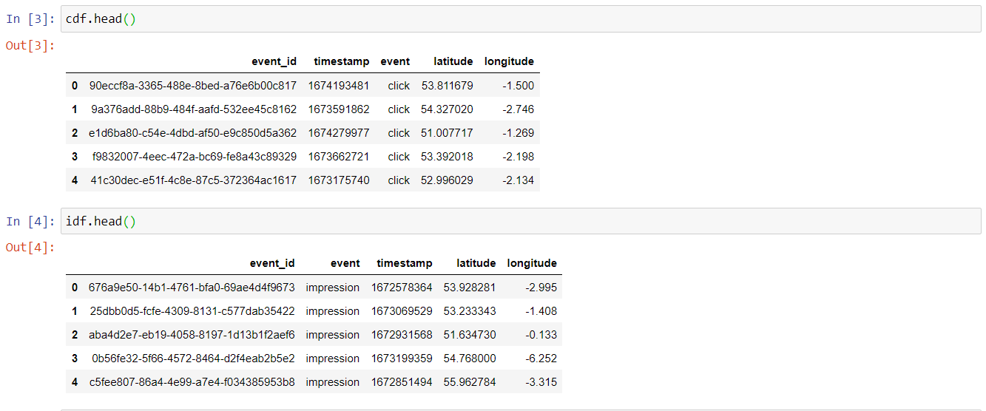
Loading data and packages
I used jupyter notebook and the pandas library to import the data from csv and added a few packages that would be needed for later.
Pandas is the ultimate Python library to manipulate data from csv into a dataframe that allows data manipulation versatility.
I created two variables (cdf and idf) which stands for clicks dataframe and impressions dataframe, respectively.
I took the top few records of each dataset to see if they are aligned

Slide 14
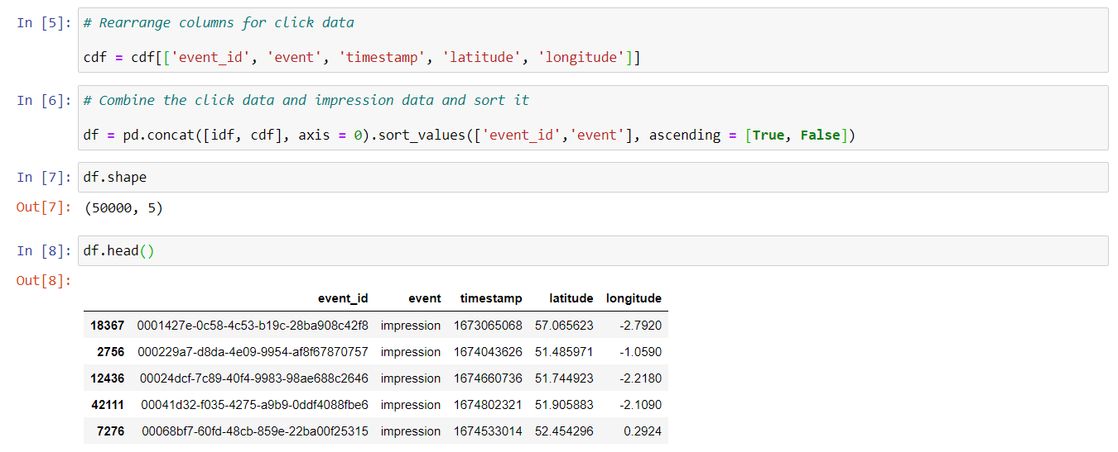
Data Manipulation
I wanted to rearrange some columns and combine the two datasets together (row wise).
Then I took the top few records from the combine new dataframe.
The reason I did this was to make data organized so I can view for any exploratory analysis.

Slide 15
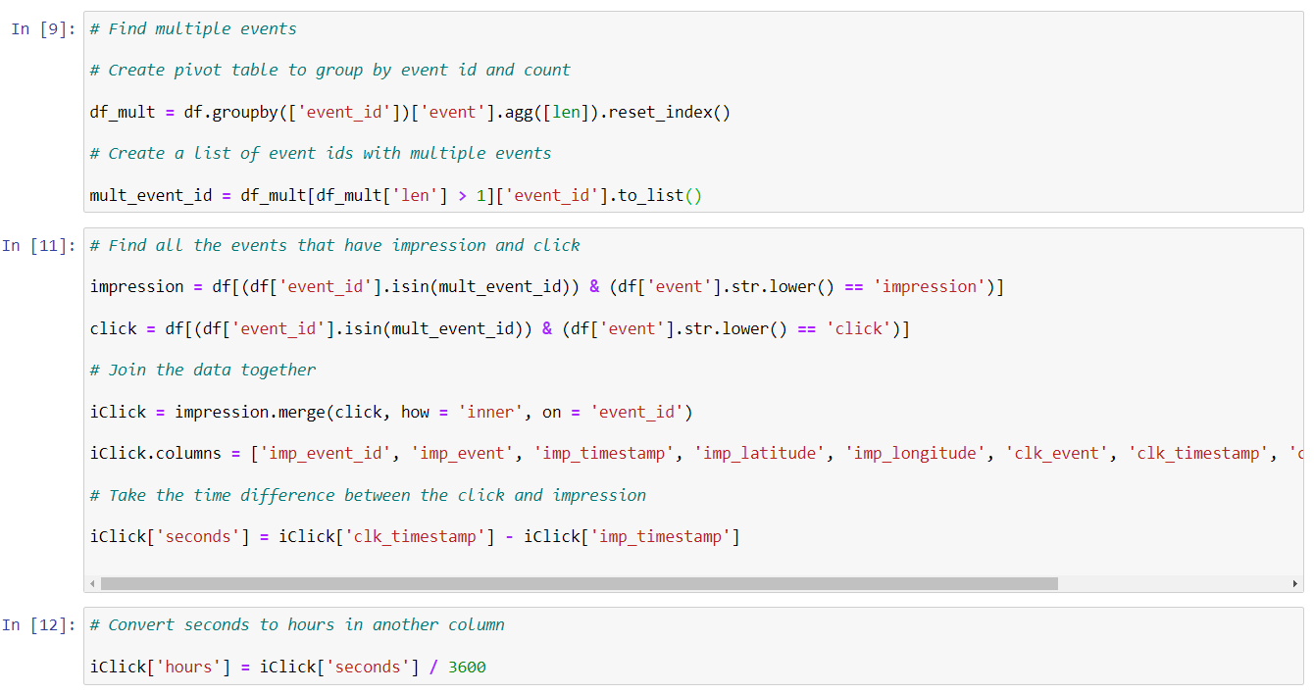
Data Manipulation
I wanted to see for the events that occurred multiple times, this would indicate an impression and click event occurred
Then I joined the data that is impression and click together to form a complete dataset named as iClick.
Then I created a column called seconds which is the time difference from impression to click. This is the time between viewing the ad and clicking it.
I also converted this into hours as this would help standardize metrics.
The main idea is that I would create KPIs such as Kmph, time and distance.

Slide 16
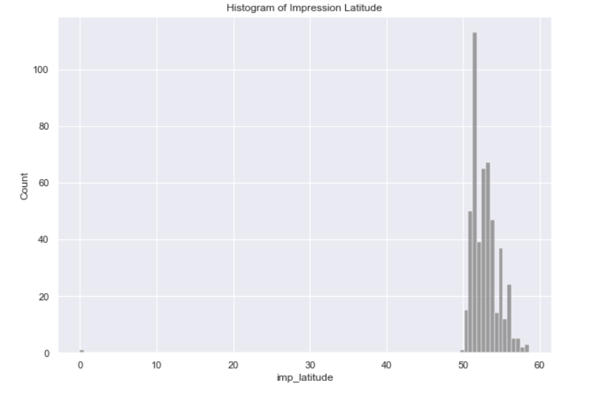
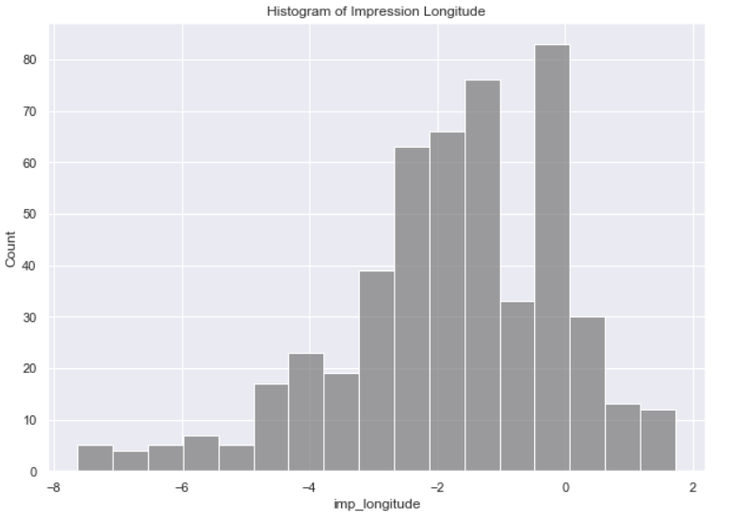
Histogram of Impression (Lat and Long)
To spot for potential outliers and sense check the distribution of impression latitude and longitude columns, I created histograms to the right for both fields.
The Python library package I used was Seaborn. This is a very neat and clean package for visualizing data.
For impression latitude there is one outlier issue at point 0.
For impression longitude, I did not see any issue as it does not look unusual.

Slide 17
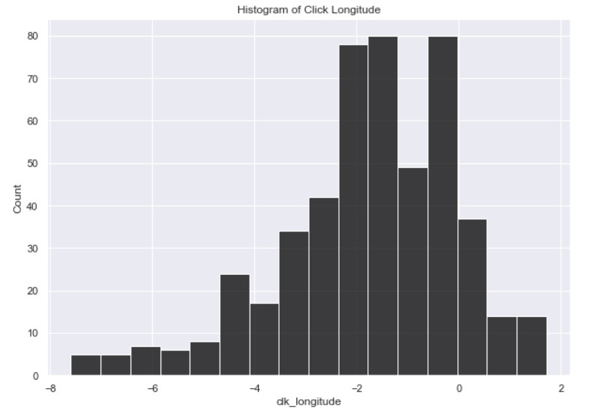
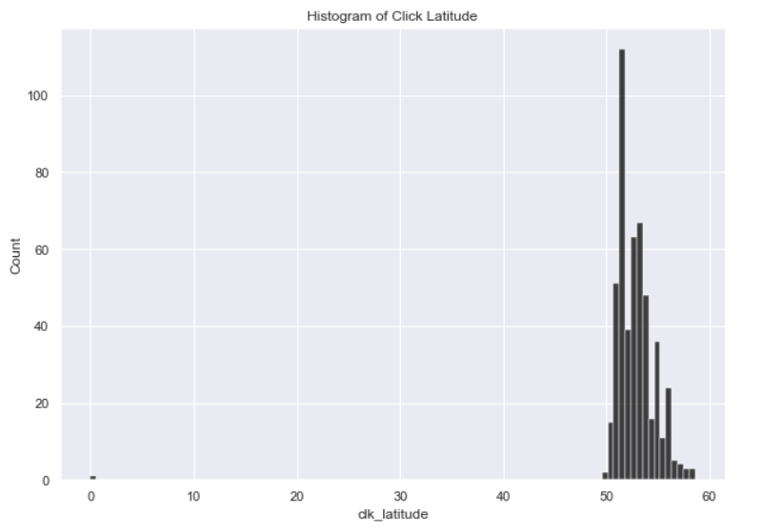
Histogram of Clicks (Lat and Long)
For Clicks latitude, you can tell there is that one outlier (point 0). This was the same issue from impression latitude.
For longitude, everything appears normal, nothing to note here.

Slide 18
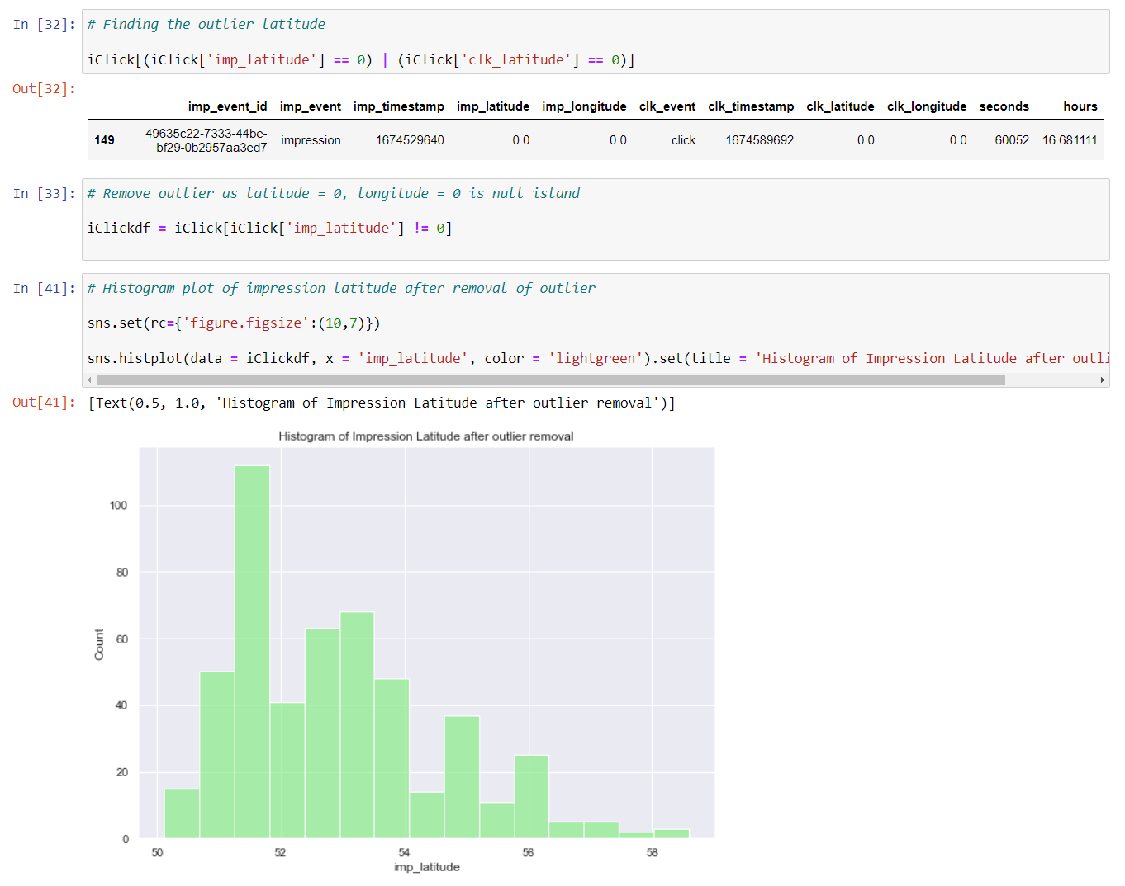
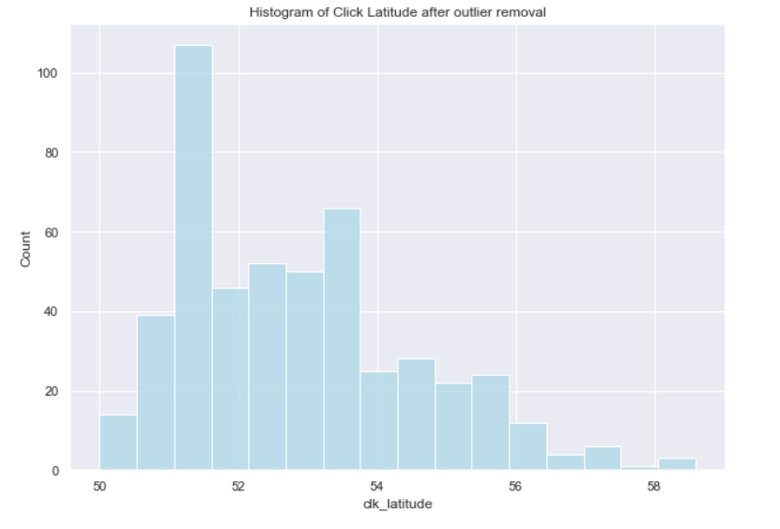
Removal of outlier
I decided to find that particular data point that had the latitude = 0 for both impression and clicks. It is shown on line [32].
I removed this from analysis in line [33] because it is considered null island, which for our analysis does not make sense.
Then I created a histogram to view the impression latitude and click latitude. The data looks much better.

Slide 19
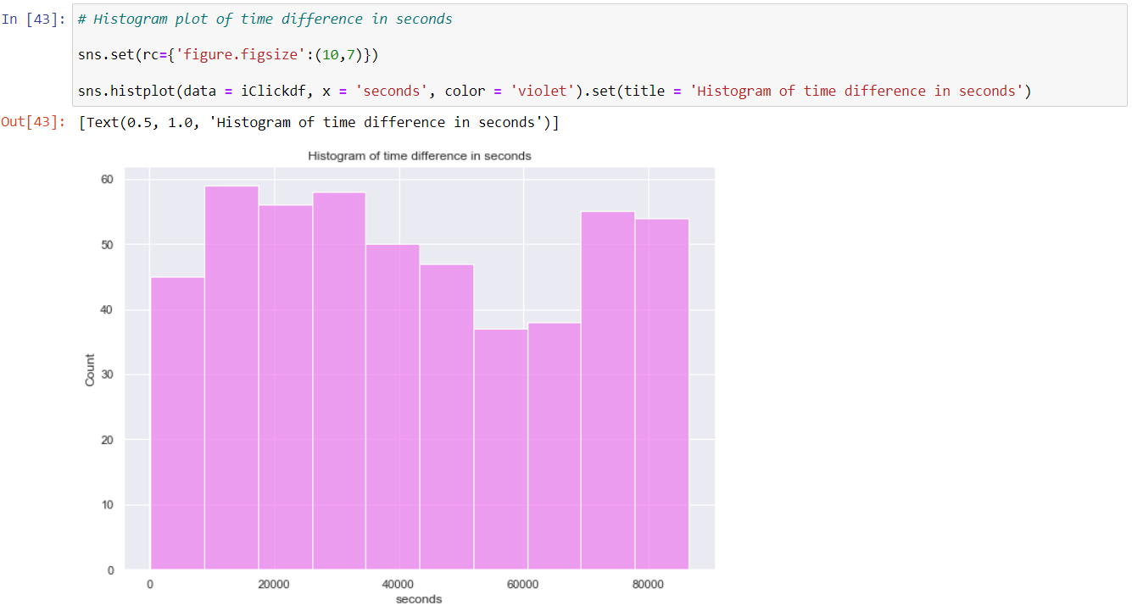
Histogram of Seconds
Since I had been creating histograms and viewing distributions, I decided to use this to see the distribution of time taken in seconds from impression to click.
Just looking at the distribution, it looks very good. It has a very uniform-like distribution, which is simply saying there is an equal likelihood chance for any time taken in seconds. There are no skewness.

Slide 20
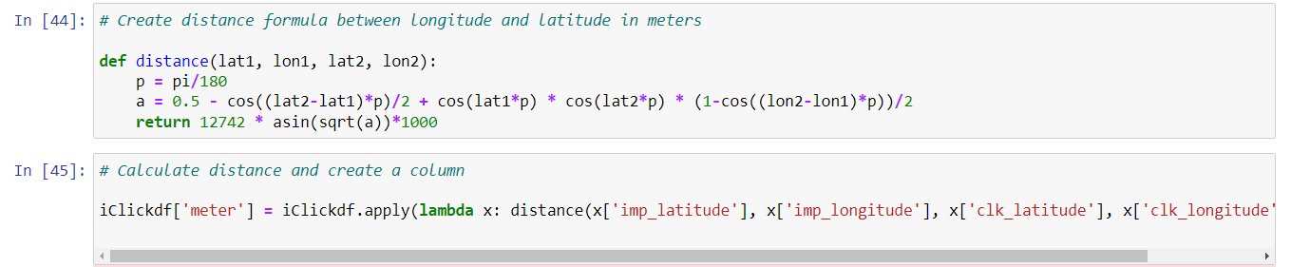
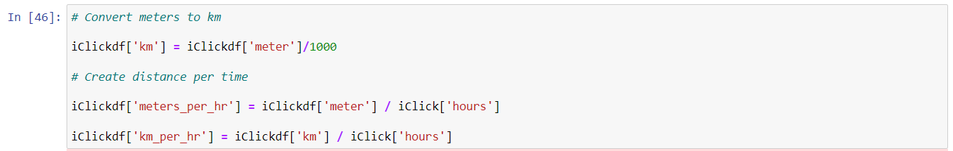
Calculating distance
In this next step, I had to calculate distance from latitude and longitude. To do so I had to create a formula that would convert the degrees into km, this is on line [44].
Once I had created the formula, I need to apply this formula into our fields (latitude and longitude) both for impression and clicks (line [45]). This is in meters.
Then I decided to convert to km and measure the Kmph.

Slide 21
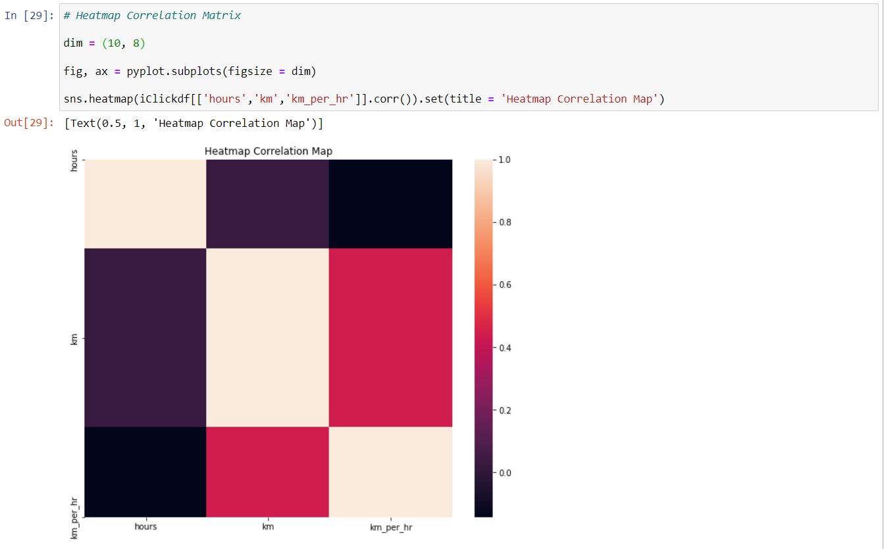
Heatmap Correlation Matrix
In the next step, I wanted to create a correlation heatmap on hours, km and kmph to see if there is any relationship between the variables before applying any machine learning algorithms. This is to ensure there is no multicollinearity issues.
Correlation simply means if a value goes up, does the other value go in the same direction or opposite direction and also how strong is this relationship.
Based on the results, the brighter the color is, the stronger the relationship is between the variable and as you can tell from the results, there are no strong relationships between each variable.

Slide 22
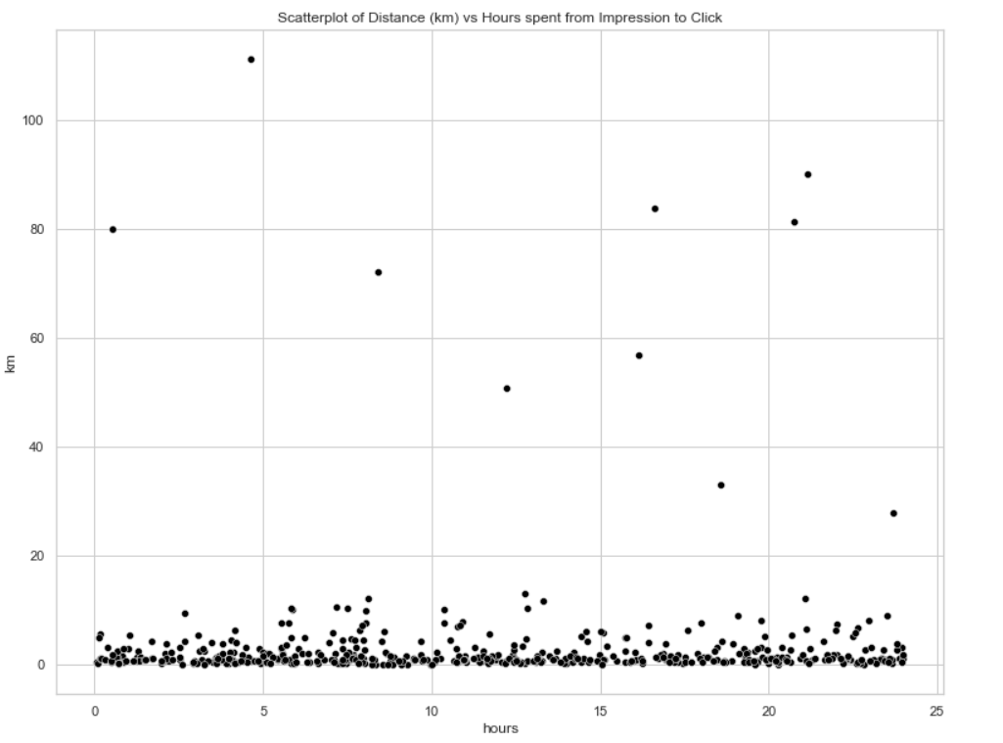
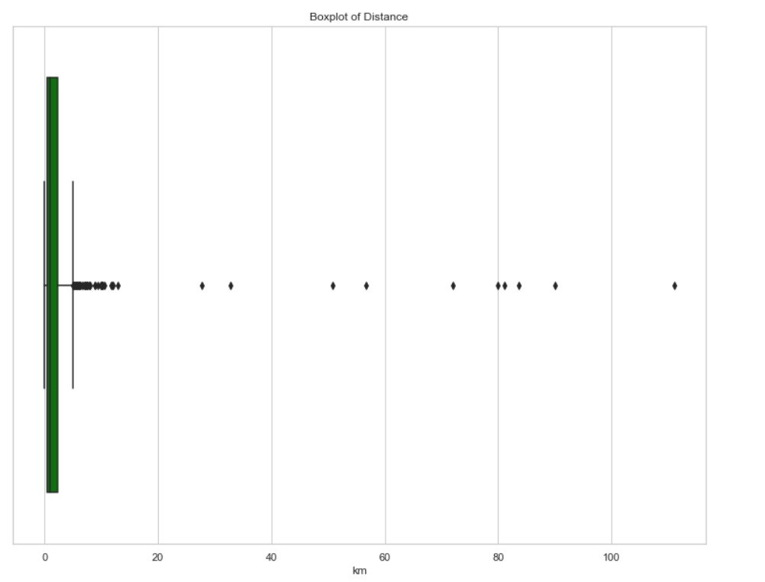
Examining Distance vs Hours
Next, I wanted to see if there are any outliers between Distance (km) and Hours from Impression to Click.
I decided to plot a scatterplot to review the variety of data points between the two variables. I also plotted a box plot below to see how large the values vary.
The idea is to get a visual interpretation of what is happening for each variable.

Slide 23
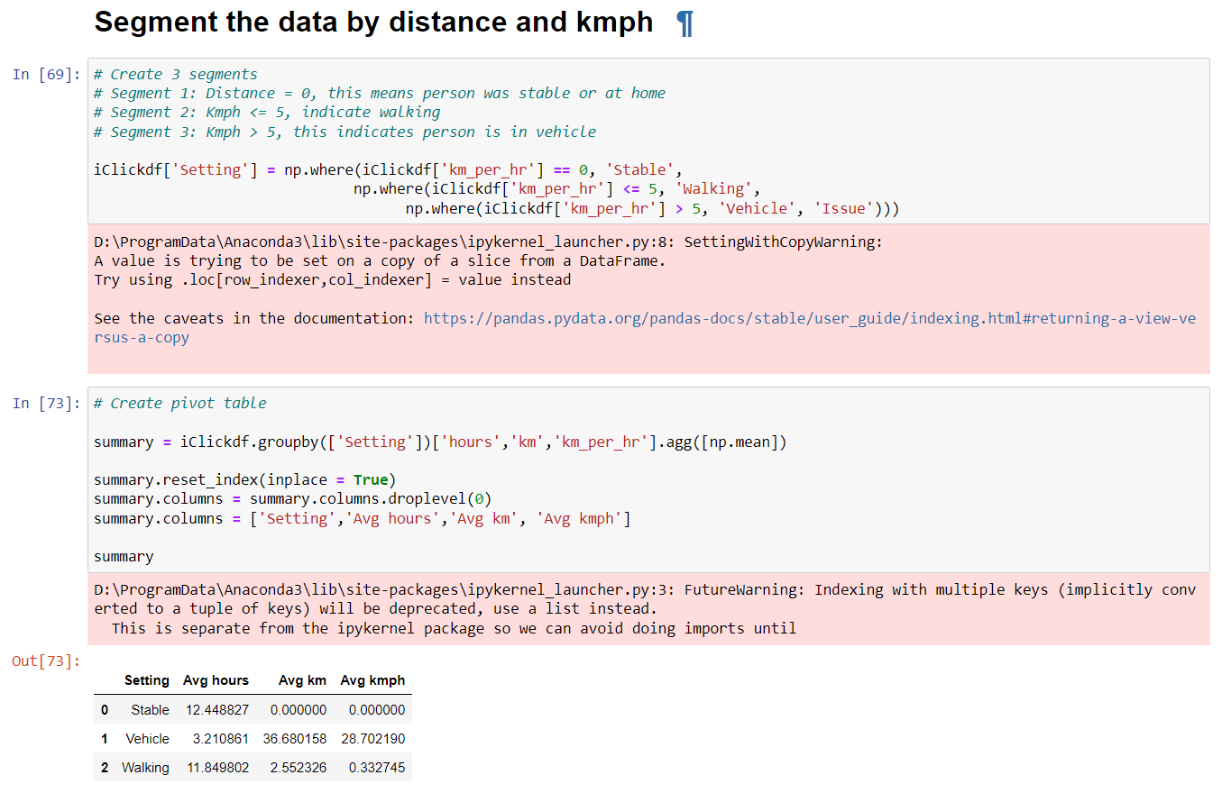
Segmenting the data
I did some research on average speed a typical person walks. Studies show that 5 kmph is a standard speed for walking. Knowing this information, I decide to segment the data.
Stable - the individual is in one location with no kmph
Walking - individuals with speeds less than or equal to 5 kmph
Vehicle - individuals with speeds more than 5 kmph
I classified the individuals as such because I felt there would be a lot of information that can be provided from this segmentation. What if those who were walking viewed the advertisement longer than individuals who were in a vehicle? This would be an interesting analysis to look into.
As you can tell I segmented the data as such and provided a summary chart displaying the average kmph, avg hours and avg km for each grouping.

Slide 24
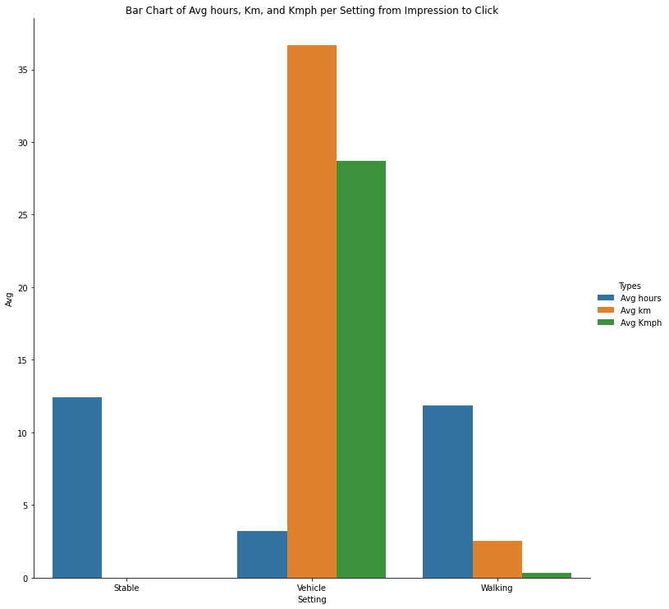
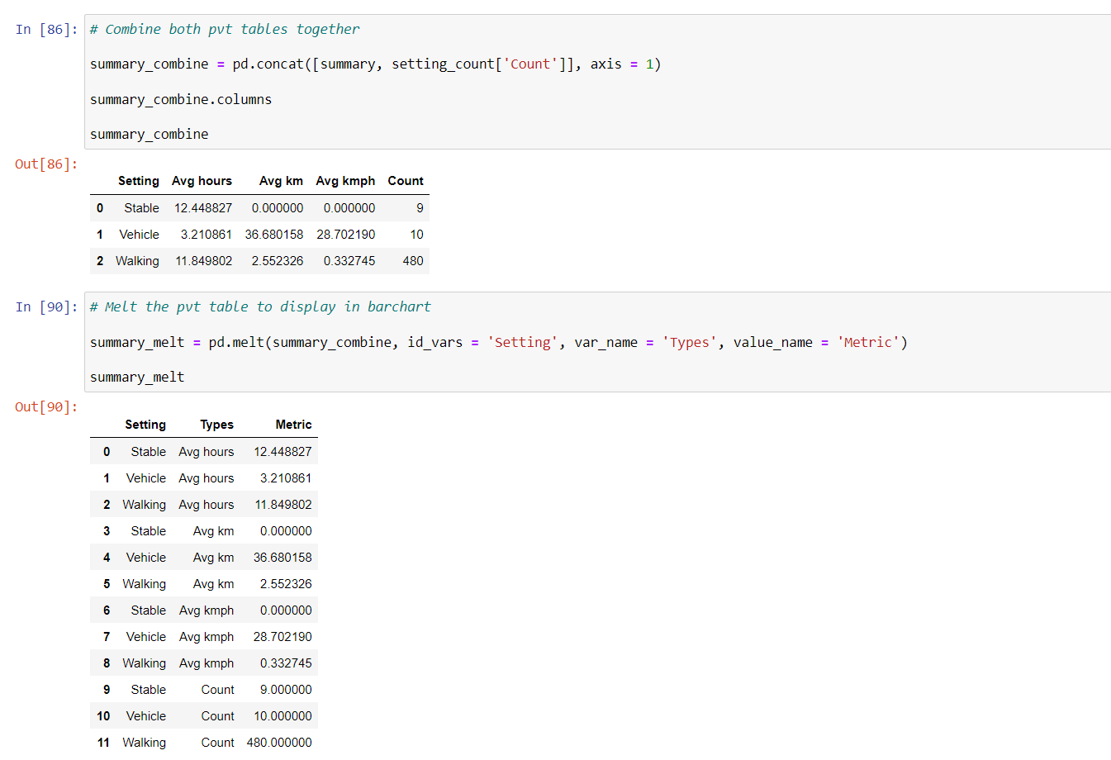
Barplot of all segments
I went ahead and plotted a barchart with the segments and metrics created. It shows everything we need to know and to confirm visually that the segmentation is correct.
In addition, I had to do some data manipulation using the pandas melt function to plot the barplot as such. (shown below)

Slide 25
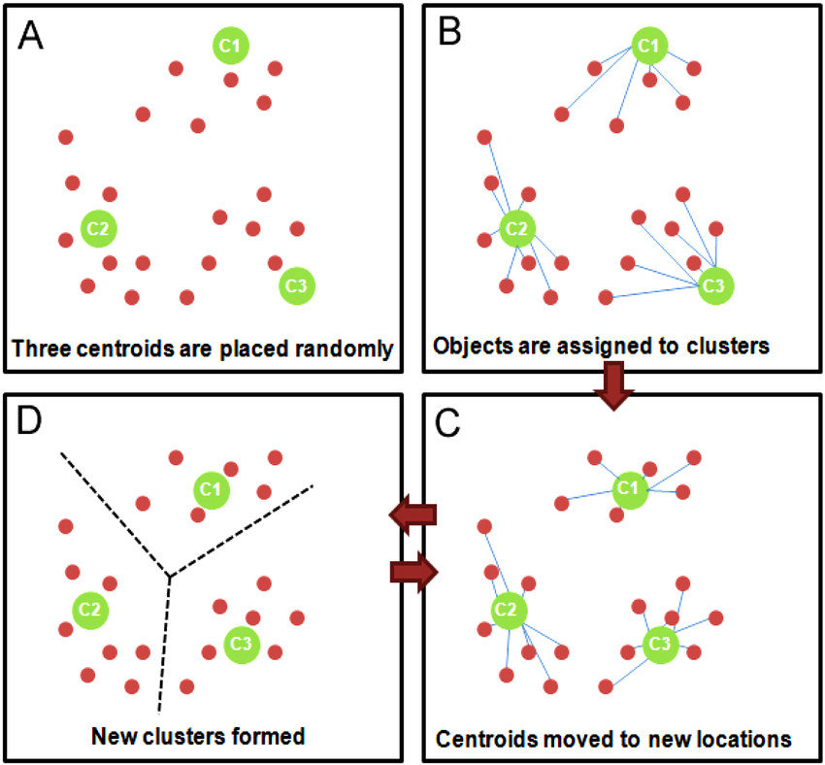
K means algorithm
Now that I had set up the segments, I wanted to see if K means algorithm can provide this same verification of information. To not only double check my results but to also see if there are additional information to be learned.
K means algorithm is an unsupervised learning technique to classify unlabeled data by grouping them by features, rather than pre-defined categories.
Essentially the algorithm segments your data by using distance between data point spanning multidimensions in your data set. The distance formula I am using is Euclidean, which is the shortest distance between data points.
It measures the distances between points and tries to group them together based on a specified k number of clusters. It uses centroids (centers of clusters) to map the cluster and updates until clusters do not change or a stoppage point occurs.

Slide 26
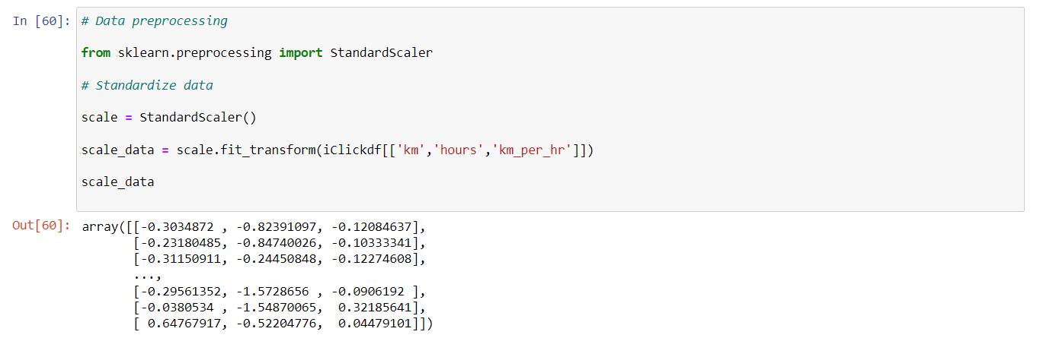
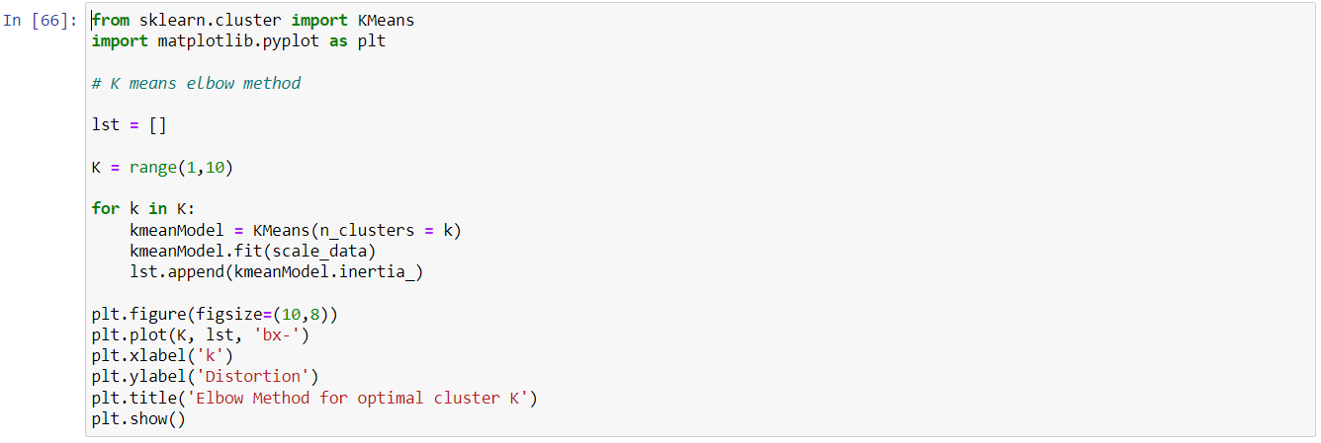
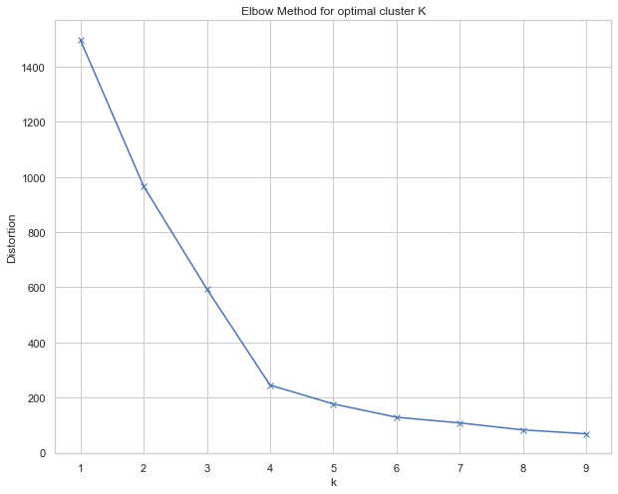
Elbow Method
Before I can apply the K means algorithm to the dataset, I need to standardize the data. The variables I used are km, hours and kmph. View line [60].
Next I would have to create Elbow Method, this allows us to understand what the optimal number of clusters is.
The Elbow Method measures the distances between the centroid (center of cluster) and the data points within the cluster. As you increase the number of clusters, there is less and less distance or “error” between the clusters and its data points within it.
So it was devised that after a certain number of clusters, there should be an elbow that shows the optimal number of clusters. Meaning after this k number of clusters, it loses efficiency.
In our scenario, the optimal k cluster number is 4, where the elbow is.

Slide 27
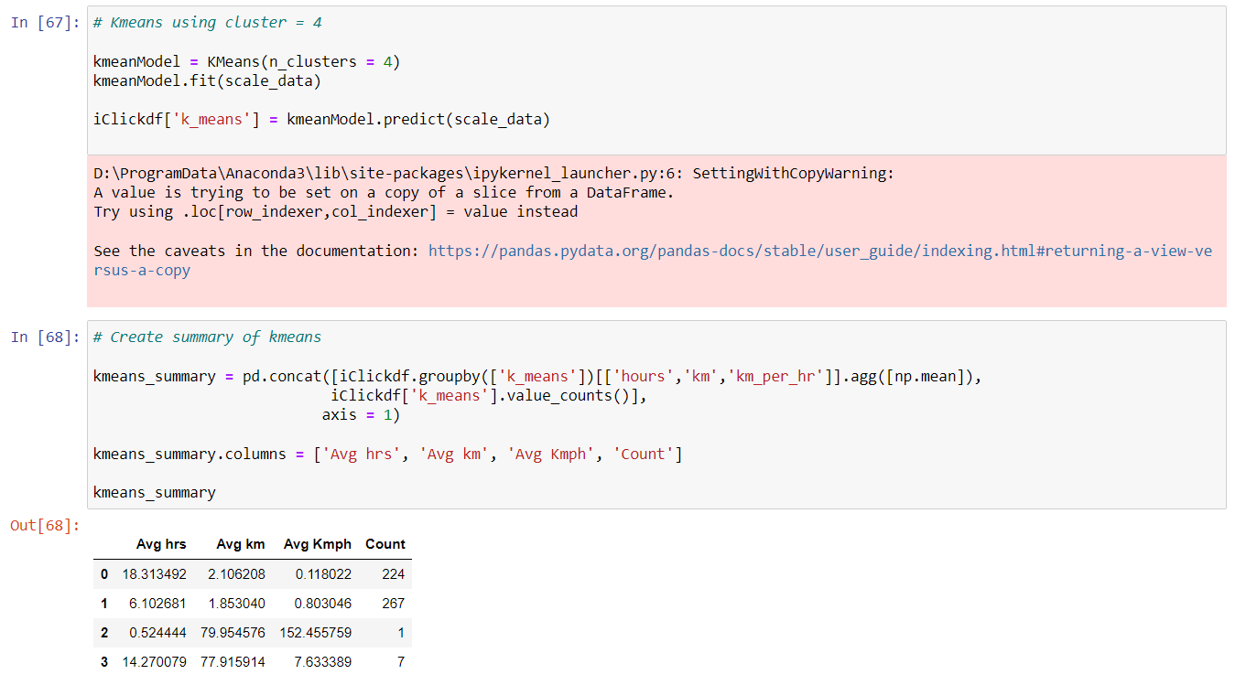
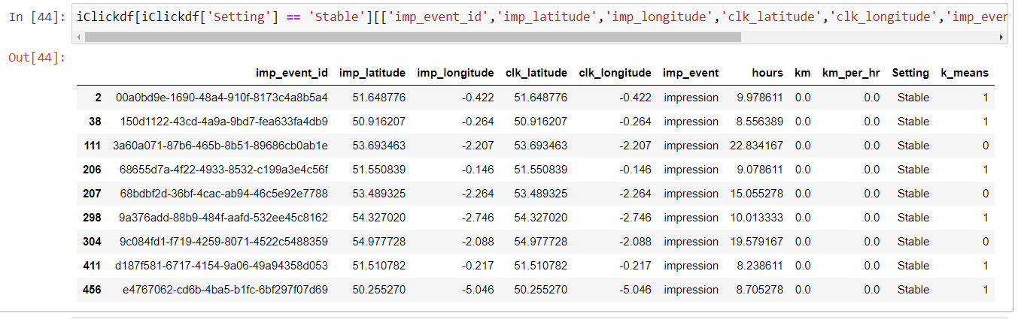
K Means Algorithm
Now that we have established the optimal number of clusters, we can now put this into a K means algorithm.
I created a summary of the results in the below chart. As you can tell there are 4 clusters and I summarized the avg hrs, avg km and avg kmph for each cluster.
Since these are the clusters assigned, I wanted to compare with my segments that I classified (Stable, Walking or Vehicle).
The easiest way to compare between my results and the k means result is to filter for the first segment - Stable.
On line [44], this is the result of Stable segment and the last column is K_means cluster. There are two clusters interfering with the segment, which shows that the K means algorithm is not segmenting it cleanly.
People who are in a stable setting should not be mingled in with others.

Slide 28
Conclusion
Find the information below:
Average time taken between impression and click event
Average distance between an impression and click event.
Based on the bar plot provided before and the chart statistics,
For setting = Stable, the average time taken is 12 hrs and 27 mins and average distance is 0 km.
For setting = Vehicle, the average time taken is 3 hrs and 12 mins and average distance is roughly 37 km.
For setting = Walking, the average time taken is 11 hrs and 51 mins and average distance is roughly 2.5 km.
Setting | Avg hours | Avg km | Avg kmph | Count
Stable | 12.45 | 0 | 0 | 9
Vehicle | 3.21 | 36.68 | 28.7 | 10
Walking | 11.85 | 2.55 | 0.33 | 480

Slide 29
Additional Thoughts
For the SQL project:
I would like to view more data from dataset1 that has more assets and more dates involved as I want to test further on the asset evaluation formula that I had come up with. For dataset2, I would like to understand more of the underlying data quality issues, why there are multiple ages or genders for each user_id. Is this because of Google account log in information? I would need to verify before diving into dataset2 as this has a lot of information to unpack if the data is clean.
For instance, we can look into the targeted audience and what gender is more likely to click on impression or convert. Also we can understand what devices are primarily used when the impression is clicked. Therefore we can tailor certain advertisements to specific audiences.
For the Python project:
I would like to understand why the average time taken is in hours. How are advertisements or impressions taking 3+ hours to be clicked on? Is the data from phone devices? Are these apps in the background in the phone? If they are apps running in background, it could make sense that there would be many hours that passed by before impression was clicked. But even in this scenario, it doesn’t make much sense because we live in a world where speed and demand need to be met quickly. We all want convenience and efficiency, this is why we have smartphones. I would need to understand where the data is coming from.
If we can somehow append the datasets from SQL and Python together to join user_ids/event_ids together, this would complete the analysis much better because we can now see the big picture. We can view the time taken for a user to click the impression and which users are most likely to convert, is it by age or gender?
I would also like to see the different products that are being advertised. Perhaps this can help tailor the advertisements to effectively target the right audience. All it takes is one impression to the right person to convert.

Slide 30
Q & A
Any questions?

